Slide 1
Project HTTP JSON API Node.js Time Server
20097 - Zeynep Salihoglu

Slide 2
PROJECT OVERVIEW
TECHNOLOGIES
The Time Server project is a basic web server built using Node.js. It serves the current date and time in JSON format when accessed via a specific endpoint. This project demonstrates the simplicity and power of Node.js for creating HTTP servers and handling routing.
Node.js: A JavaScript runtime built on, used for server-side programming.
HTTP Module: Built-in Node.js module used to create the server and handle HTTP requests and responses.

Slide 3
OBJECTIVES
Gain hands-on experience with Node.js, including setting up a Node.js environment and running a basic server.
Utilize the built-in http module in Node.js to create and configure an HTTP server.
Retrieve the current date and time using JavaScript's Date object.
Format the date and time into a readable JSON structure.

Slide 4
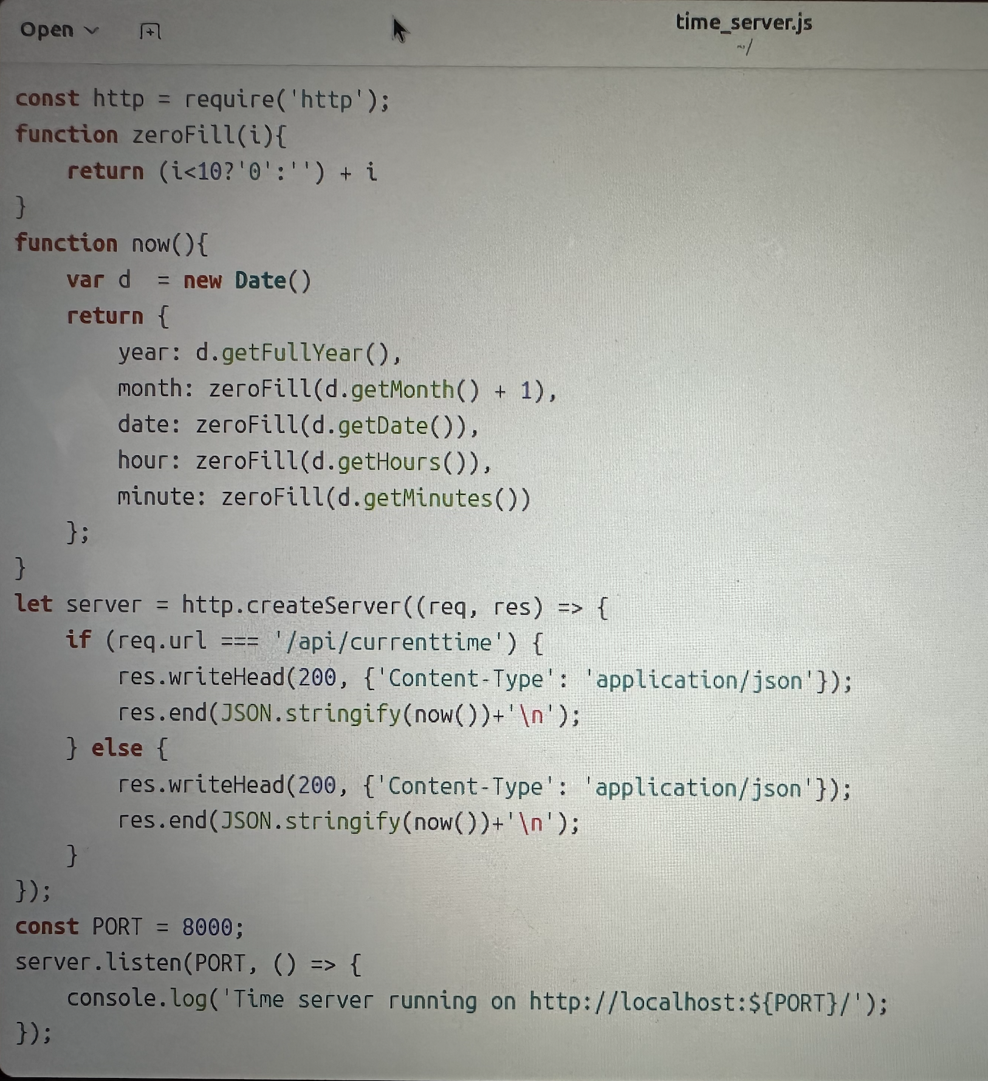
CODE
Import HTTP module
Get the current date and time in a JSON format
Create HTTP server
Listening on PORT 8000

Slide 5
Running on server:
node time_server.js

Slide 6
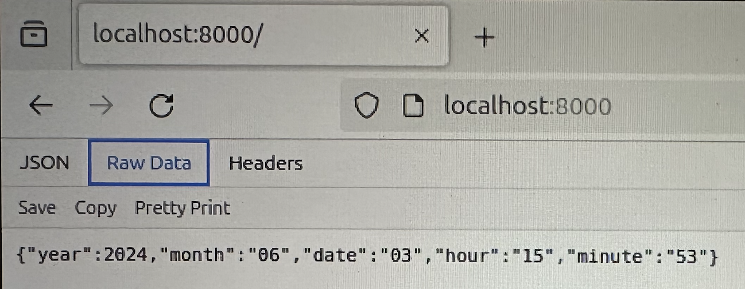
Displaying in server browser:
http://localhost:8000/

Slide 7
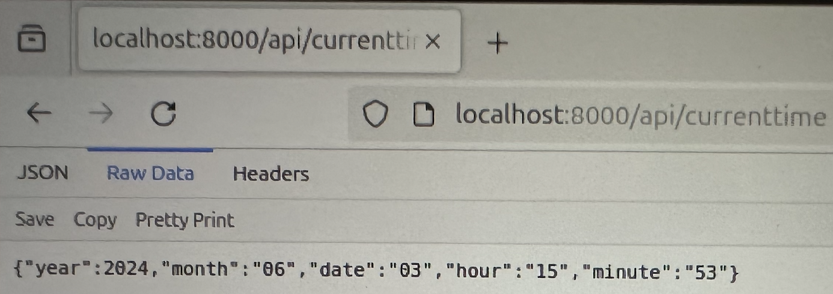
Displaying in client side browser:
http://localhost:8000/api/currenttime

Slide 8
CONCLUSION
The Time Server project is a straightforward and educational example of creating a web server with Node.js. It highlights how to handle HTTP requests, format data, and respond with JSON, making it a useful starting point for beginners exploring server-side JavaScript development.

Slide 9
REFERENCES
https://hc.labnet.sfbu.edu/~henry/npu/classes/javascript/node_js/slide/ubuntu.html
https://hc.labnet.sfbu.edu/~henry/npu/classes/javascript/node_js/course/nodeschool/learnyounode/time_server.html
https://hc.labnet.sfbu.edu/~henry/npu/classes/javascript/node_js/hw/q8/2021_spring/cs571_week2_Nodejs_time_server_Quan_Zhou.pdf
https://hc.labnet.sfbu.edu/~henry/npu/classes/javascript/json/slide/index_slide.html
https://hc.labnet.sfbu.edu/~henry/npu/classes/javascript/node_js/course/nodeschool/learnyounode/http_json_api_server.html
https://hc.labnet.sfbu.edu/~henry/npu/classes/javascript/node_js/course/nodeschool/learnyounode/http_json_api_server.html

